Slide 1
Chapter 9 : Dictionaries
Amni Saizan

Slide 2
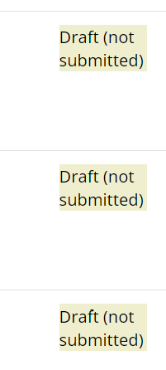
Comments on PBL submission
Please press submit betul2. ada yg status →
Individually submit, all members to submit.

Slide 3
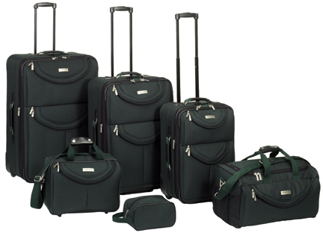
What is a Collection?
A collection is nice because we can put more than one value in them and carry them all around in one convenient package.
We have a bunch of values in a single “variable”
We do this by having more than one place “in” the variable.
We have ways of finding the different places in the variable

Slide 4
What is not a “Collection”
Most of our variables have one value in them - when we put a new value in the variable - the old value is over written
$ python
Python 2.5.2 (r252:60911, Feb 22 2008, 07:57:53)
[GCC 4.0.1 (Apple Computer, Inc. build 5363)] on darwin
>>> x = 2
>>> x = 4
>>> print x
4

Slide 5
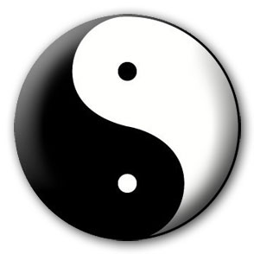


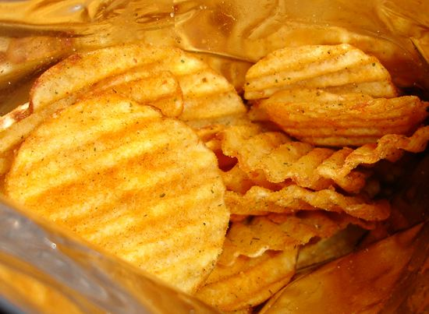
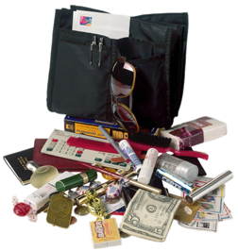
A Story of Two Collections..
List
  A linear collection of values that stay in order
Dictionary
  A “bag” of values, each with its own label

Slide 6
Dictionaries
Dictionaries are Python’s most powerful data collection
Dictionaries allow us to do fast database-like operations in Python
Dictionaries have different names in different languages
  Associative Arrays - Perl / Php
  Properties or Map or HashMap - Java
  Property Bag - C# / .Net
http://en.wikipedia.org/wiki/Associative_array

Slide 7
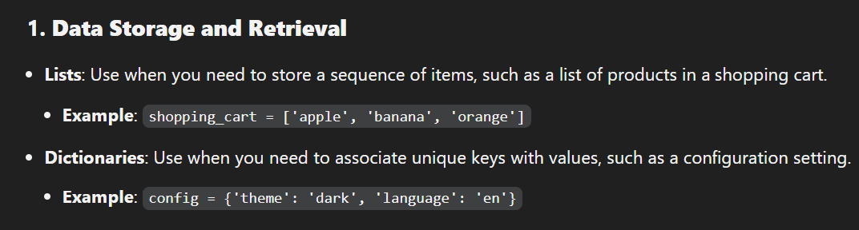
Difference in application

Slide 8
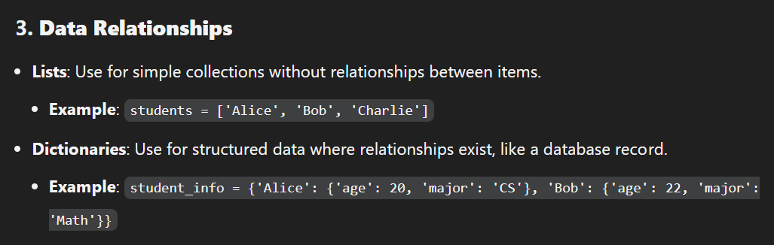
Difference in application

Slide 9
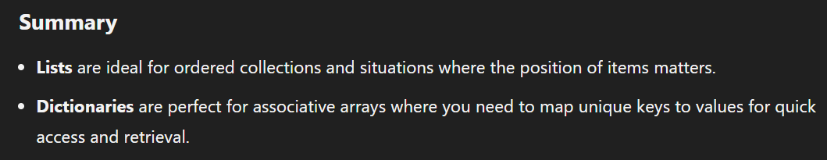
Difference in application..summary

Slide 10
Dictionaries
Lists index their entries based on the position in the list
Dictionaries are like bags - no order
So we index the things we put in the dictionary with a “lookup tag”
>>> purse = dict() # declare
>>> purse['money'] = 12 # indexing
>>> purse['candy'] = 3
>>> purse['tissues'] = 75
>>> print purse
{'money': 12, 'tissues': 75, 'candy': 3}
>>> print purse['candy']
3
>>> purse['candy'] = purse['candy'] + 2’
>>> print purse
{'money': 12, 'tissues': 75, 'candy': 5}

Slide 11
Comparing Lists and Dictionaries
Dictionaries are like Lists except that they use keys instead of numbers to look up values
>>> lst = list()
>>> lst.append(21)
>>> lst.append(183)
>>> print lst
[21, 183]
>>> lst[0] = 23
>>> print lst
[23, 183]
>>> ddd = dict()
>>> ddd['age'] = 21
>>> ddd['course'] = 182
>>> print ddd
{'course': 182, 'age': 21}
>>> ddd['age'] = 23
>>> print ddd
{'course': 182, 'age': 23}

Slide 12
>>> lst = list()
>>> lst.append(21)
>>> lst.append(183)
>>> print lst
[21, 183]
>>> lst[0] = 23
>>> print lst
[23, 183]
List
Key
Value
[0]
21
lll
[1]
183
>>> ddd = dict()
>>> ddd['age'] = 21
>>> ddd['course'] = 182
>>> print ddd
{'course': 182, 'age': 21}
>>> ddd['age'] = 23
>>> print ddd
{'course': 182, 'age': 23}
Dictionary
Key
Value(as index)
['course']
183
ddd
['age']
21

Slide 13
Dictionary Literals (Constants)
Dictionary literals use curly braces and have a list of key : value pairs
You can make an empty dictionary using empty curly braces
>>> jjj = { 'chuck' : 1 , 'fred' : 42, 'jan': 100}
>>> print jjj
{'jan': 100, 'chuck': 1, 'fred': 42}
>>> ooo = { }
>>> print ooo
{}
>>>

Slide 14
Most Common Name?
marquard
cwen
zhen
zhen
csev
zhen
csev
marquard
marquard
csev
cwen
zhen
zhen

Slide 15
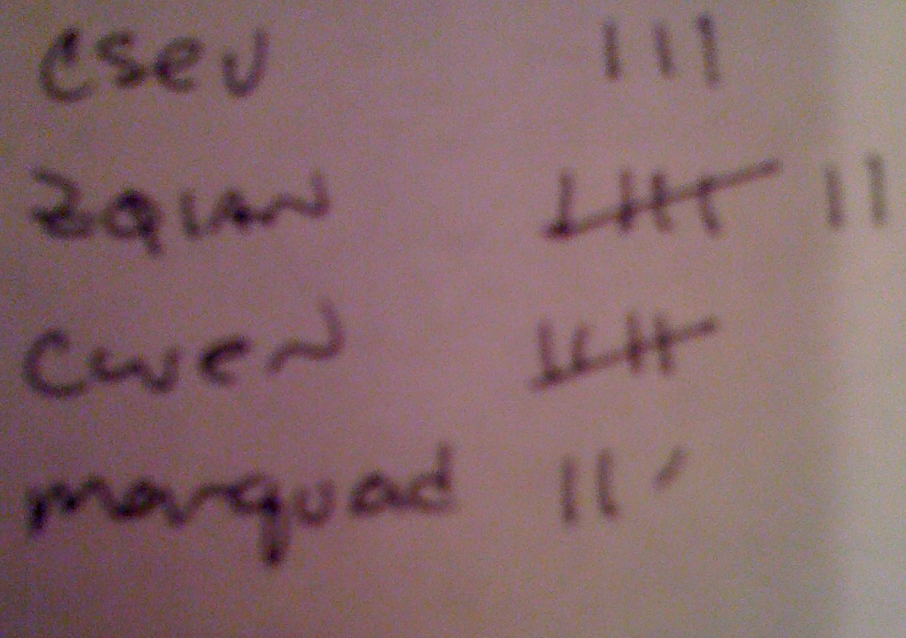
Many Counters with a Dictionary
One common use of dictionary is counting how often we “see” something
Key
Value
>>> ccc = dict()
>>> ccc['csev'] = 1
>>> ccc['cwen'] = 1
>>> print ccc
{'csev': 1, 'cwen': 1}
>>> ccc['cwen'] = ccc['cwen'] + 1
>>> print ccc
{'csev': 1, 'cwen': 2}

Slide 16
Dictionary Tracebacks
It is an error to reference a key which is not in the dictionary
We can use the in operator to see if a key is in the dictionary
>>> ccc = dict()
>>> print ccc['csev']
Traceback (most recent call last):
File "<stdin>", line 1, in <module>
KeyError: 'csev'
>>> print 'csev' in ccc
False

Slide 17
When we see a new name
When we encounter a new name, we need to add a new entry in the dictionary and if this the second or later time we have seen the name, we simply add one to the count in the dictionary under that name
counts = dict()
names = ['csev', 'cwen', 'csev', 'zqian', 'cwen']
for name in names :
if name not in counts:
counts[name] = 1
else :
counts[name] = counts[name] + 1
print counts
{'csev': 2, 'zqian': 1, 'cwen': 2}

Slide 18
BREAK

Slide 19
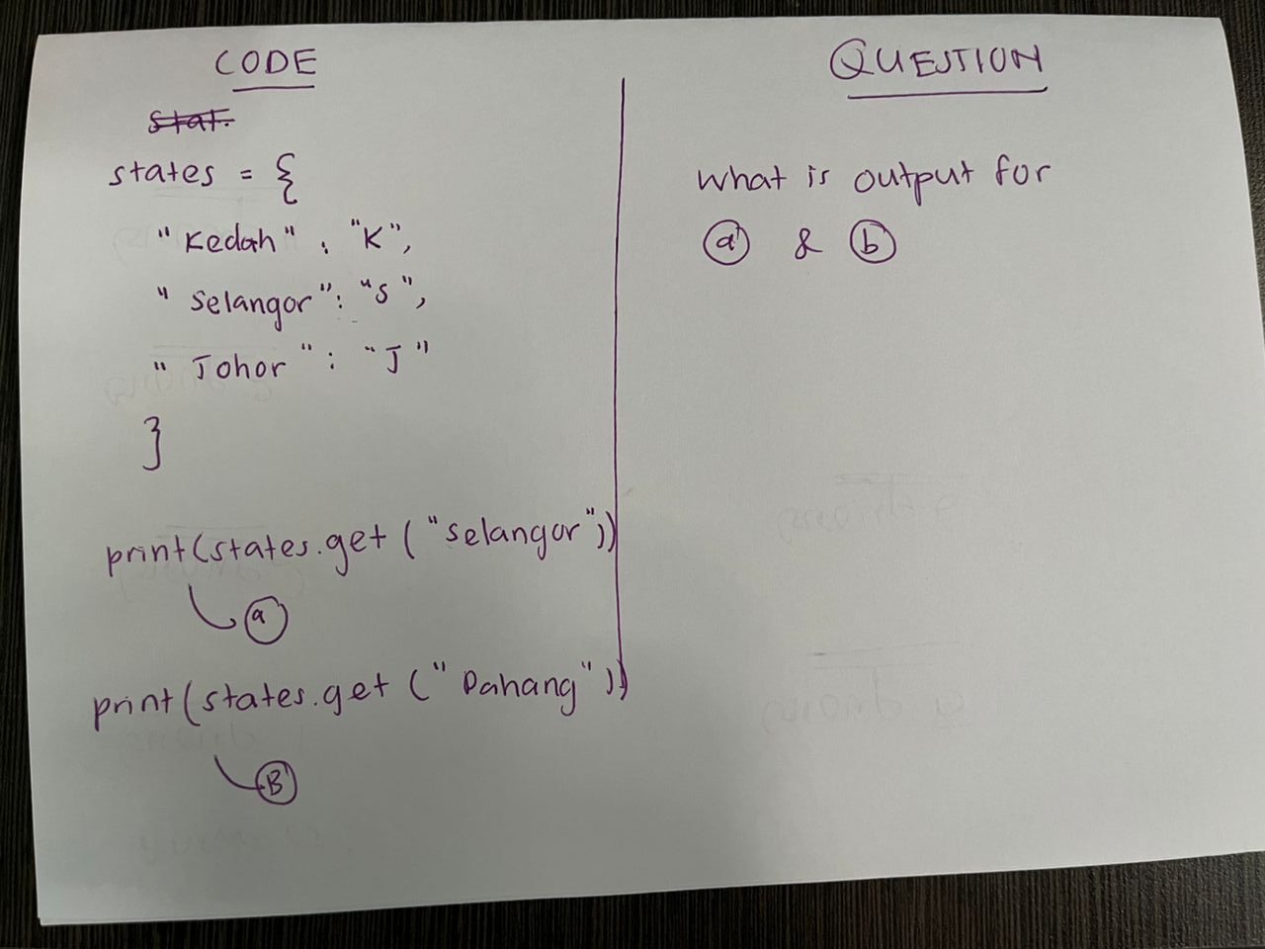
FRONT

Slide 20
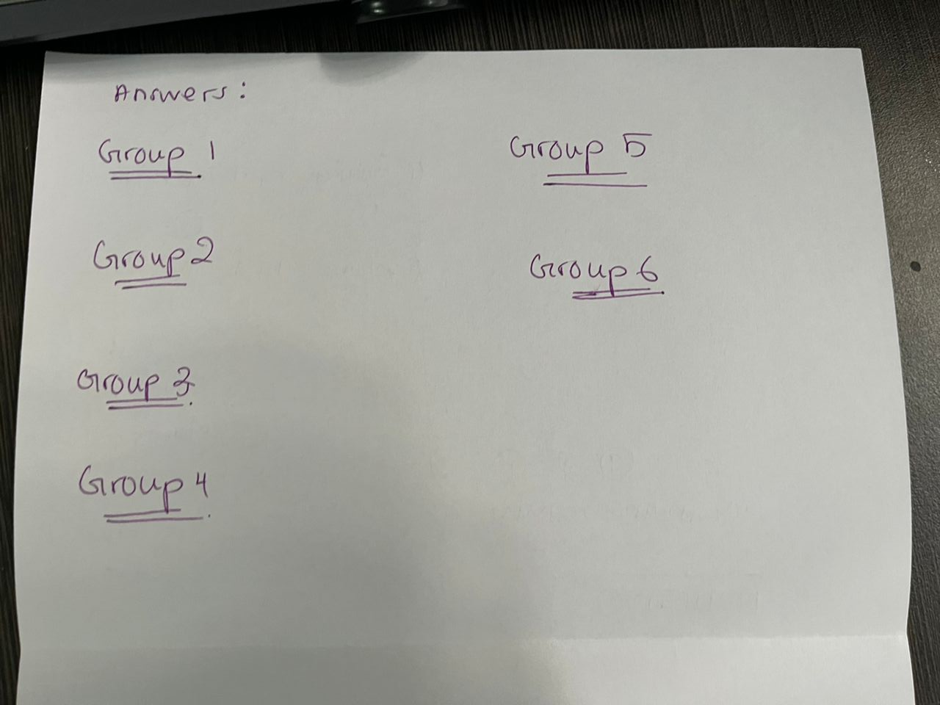
BACK

Slide 21
The get method for dictionaries
This pattern of checking to see if a key is already in a dictionary and assuming a default value if the key is not there is so common, that there is a method called get() that does this for us
if name in counts:
x = counts[name]
else :
x = 0
x = counts.get(name, 0)
Default value if key does not exist (and no Traceback).
{'csev': 2, 'zqian': 1, 'cwen': 2}

Slide 22
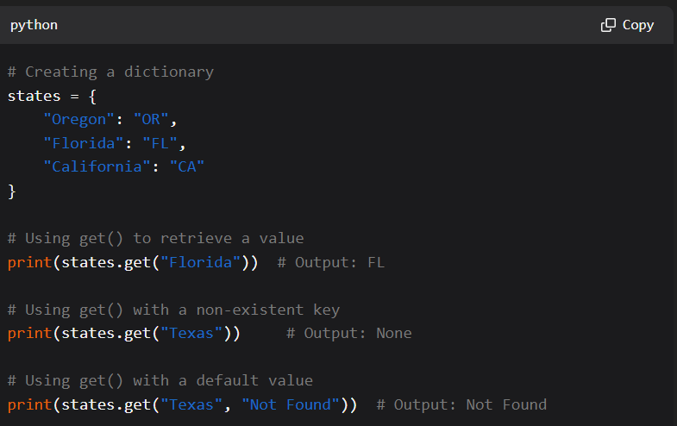

Slide 23

Simplified counting with get()
We can use get() and provide a default value of zero when the key is not yet in the dictionary - and then just add one
counts = dict()
names = ['csev', 'cwen', 'csev', 'zqian', 'cwen']
for name in names :
counts[name] = counts.get(name, 0) + 1
print counts
{'csev': 2, 'zqian': 1, 'cwen': 2}
Default

Slide 24
Simplified counting with get()
counts = dict()
names = ['csev', 'cwen', 'csev', 'zqian', 'cwen']
for name in names :
counts[name] = counts.get(name, 0) + 1
print counts
http://www.youtube.com/watch?v=EHJ9uYx5L58

Slide 25
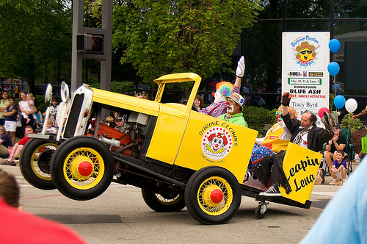
the clown ran after the car and the car ran into the tent and the tent fell down on the clown and the car

Slide 26
Counting Pattern
The general pattern to count the words in a line of text is to split the line into words, then loop thrugh the words and use a dictionary to track the count of each word independently.
counts = dict()
print 'Enter a line of text:
line = input('')
words = line.split()#based on whitespace
print 'Words:', words
print 'Counting... '
for word in words:
counts[word] = counts.get(word,0) + 1
print 'Counts', counts
Splitting: The input line is split into individual words using the split() method, which separates the string based on whitespace.

Slide 27
Counting Words
python wordcount.py
Enter a line of text:the clown ran after the car and the car ran into the tent and the tent fell down on the clown and the car
Words: ['the', 'clown', 'ran', 'after', 'the', 'car', 'and', 'the', 'car', 'ran', 'into', 'the', 'tent', 'and', 'the', 'tent', 'fell', 'down', 'on', 'the', 'clown', 'and', 'the', 'car']
Counting...
Counts {'and': 3, 'on': 1, 'ran': 2, 'car': 3, 'into': 1, 'after': 1, 'clown': 2, 'down': 1, 'fell': 1, 'the': 7, 'tent': 2}
http://www.flickr.com/photos/71502646@N00/2526007974/

Slide 28
python wordcount.py
Enter a line of text:the clown ran after the car and the car ran into the tent and the tent fell down on the clown and the car
Words: ['the', 'clown', 'ran', 'after', 'the', 'car', 'and', 'the', 'car', 'ran', 'into', 'the', 'tent', 'and', 'the', 'tent', 'fell', 'down', 'on', 'the', 'clown', 'and', 'the', 'car']Counting...
Counts {'and': 3, 'on': 1, 'ran': 2, 'car': 3, 'into': 1, 'after': 1, 'clown': 2, 'down': 1, 'fell': 1, 'the': 7, 'tent': 2}
counts = dict()
print 'Enter a line of text:
'line =input('')
words = line.split()
print 'Words:', words
print 'Counting...’
for word in words:
counts[word] = counts.get(word,0) + 1
print 'Counts', counts

Slide 29
Definite Loops and Dictionaries
Even though dictionaries are not stored in order, we can write a for loop that goes through all the entries in a dictionary - actually it goes through all of the keys in the dictionary and looks up the values
>>> counts = { 'chuck' : 1 , 'fred' : 42, 'jan': 100}
>>> for key in counts:
... print key, counts[key]
...
jan 100chuck 1fred 42
>>>

Slide 30
Retrieving lists of Keys and Values
You can get a list of keys, values or items (both) from a dictionary
>>> jjj = { 'chuck' : 1 , 'fred' : 42, 'jan': 100}
>>> print list(jjj)
['jan', 'chuck', 'fred']
>>> print jjj.keys()
['jan', 'chuck', 'fred']
>>> print jjj.values()
[100, 1, 42]
>>> print jjj.items()
[('jan', 100), ('chuck', 1), ('fred', 42)]>>>
What is a 'tuple'? - coming soon...

Slide 31
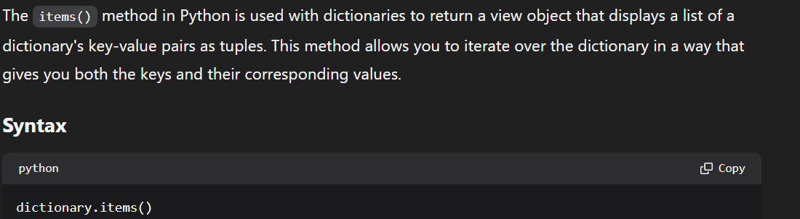

Slide 32
Bonus: Two Iteration Variables!
We loop through the key-value pairs in a dictionary using *two* iteration variables
Each iteration, the first variable is the key and the the second variable is the corresponding value for the key
>>> jjj = { 'chuck' : 1 , 'fred' : 42, 'jan': 100}
>>> for aaa,bbb in jjj.items() :
... print aaa, bbb
...
jan 100
chuck 1
fred 42
>>>
aaa
bbb
[jan]
100
[chuck]
1
[fred]
42

Slide 33
TASK ONE
Create a simple dictionary programming that the output will print the ‘key’ and ‘value’ . Output would be like this :-
1 One
2 Two
3 Three
4 Four
# use ‘for’

Slide 34
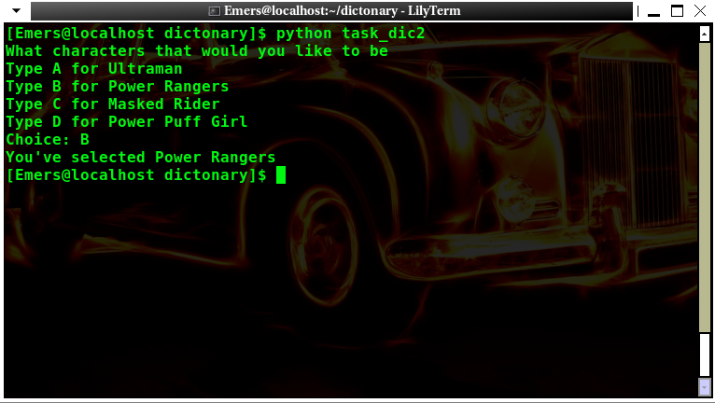
TASK TWO
Write some programming that required user input and the output should be like this :-

Slide 35
Summary
What is a collection?
Lists versus Dictionaries
Dictionary constants
The most common word
Using the get() method
Hashing, and lack of order
Writing dictionary loops
Sneak peek: tuples
Sorting dictionaries

